Slide 1



  A note on formatting:
  Each slide comes with key speaking and instructional information for PHNs and teachers in the ‘presenter notes’ part of the powerpoint.
  The font in italics is a script outline- suggestions of words you could say verbally on that slides.
  The “Notes:” unitalicized sections include instructions and tips for the PHN and teacher that are not meant to be read out loud
  Slide background is coloured accordingly: beige = lesson, blue = interactive activity, teal = optional
PILOT: September 2024
School Health Promotion:
Physical Health
Strengthening Social Connection:
Movement Makes Us Happy and Healthy
Module #2

Slide 2
PILOT: September 2024
School Health Promotion:
Physical Health
PHN Name, Role
& Fun Fact
Notes:
Introduce yourself as a PHN—Name, Role--Who you are, what you do, why you're here, and a fun fact. Option: add a photo of pet, hobby, or fun fact
Share something with the students that will help build rapport (e.g., mention that you have a cat or dog, or you like to play soccer, or explain why you’re passionate about health promotion).

Slide 3

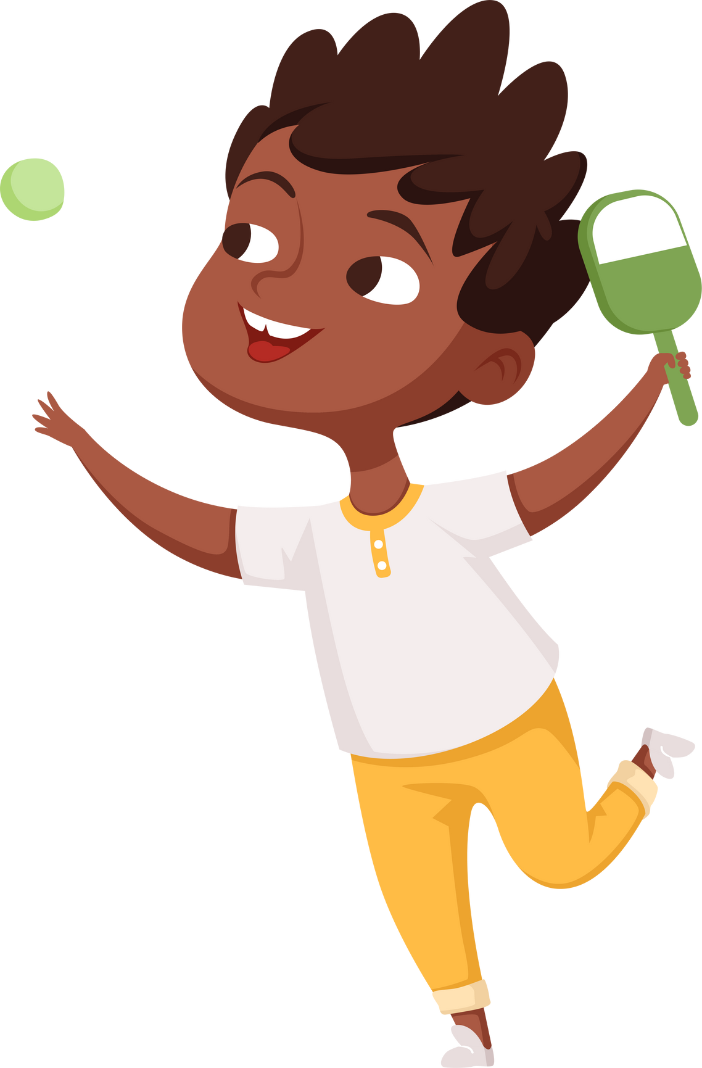

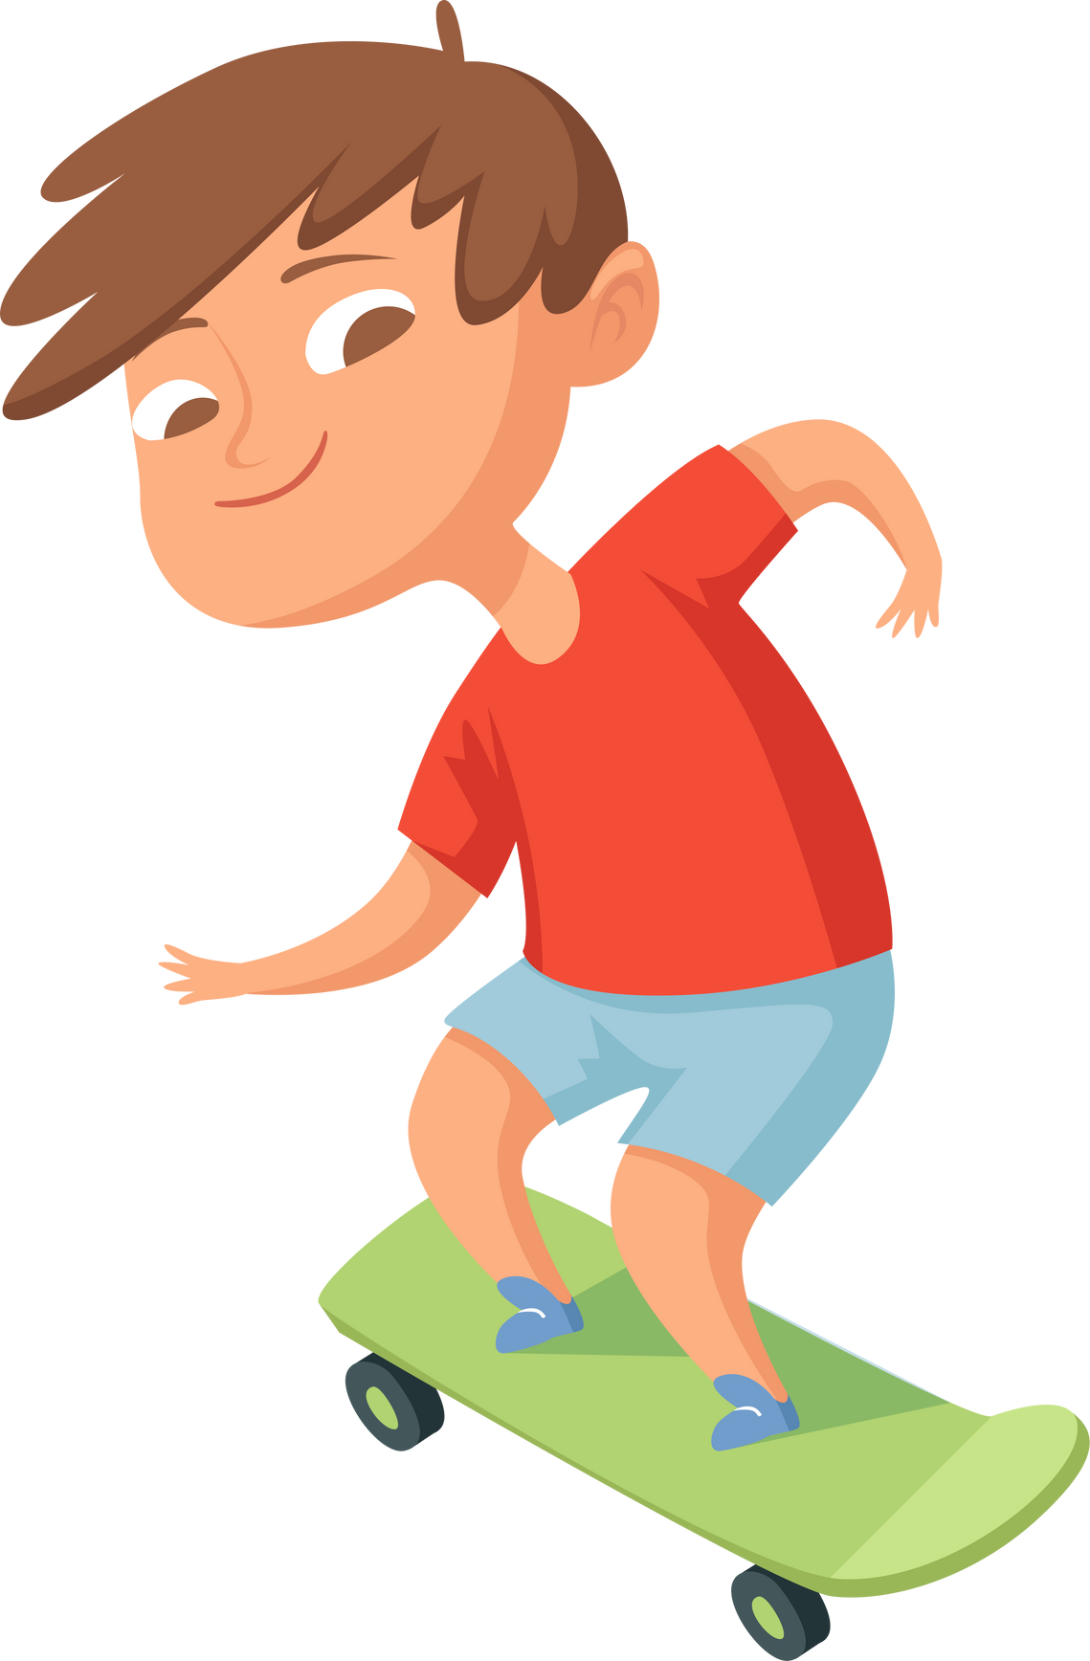
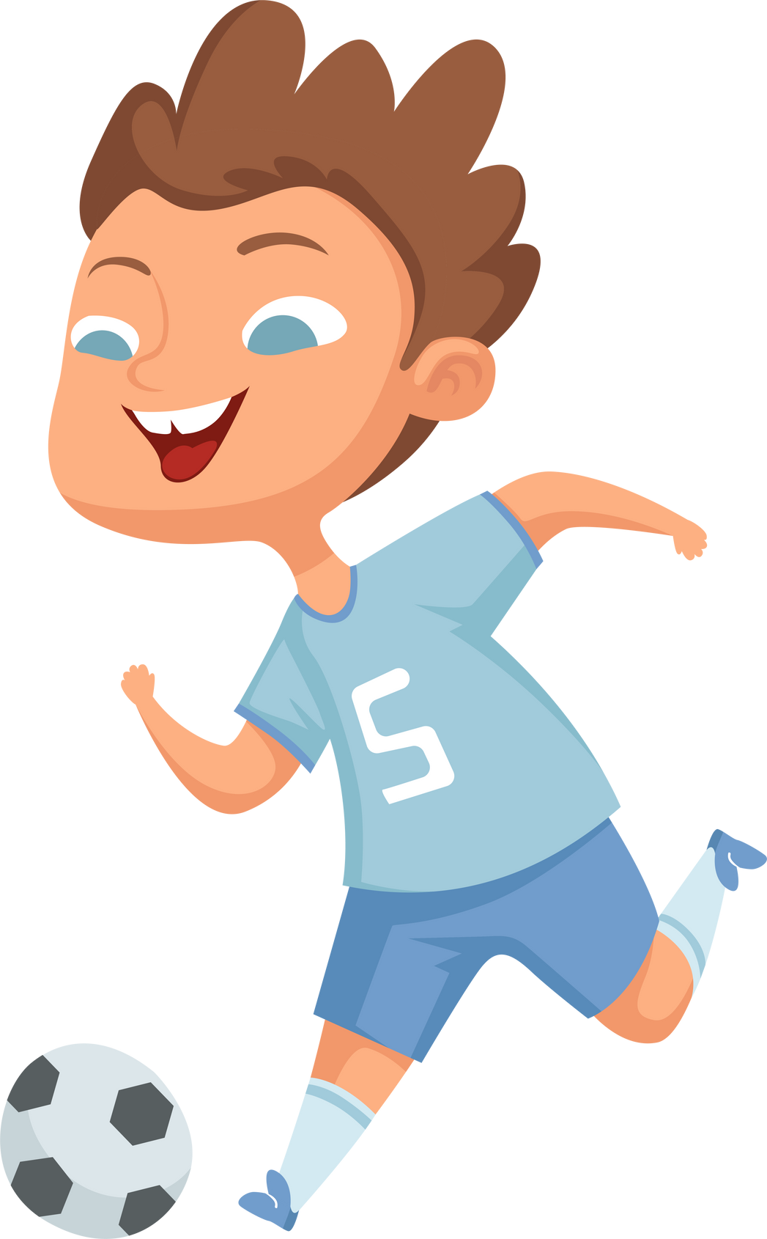
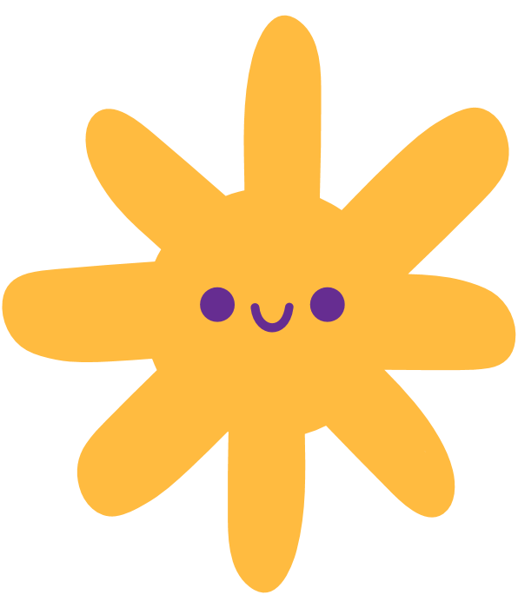

Physical Health
Movement Makes Us Happy and Healthy
September 2024
Notes:
Notes: Although moving our bodies and learning to be physically literate helps to support our physical health (our muscles get stronger, we can run further and faster, and we can play hopscotch or climb trees), physical activity also releases powerful chemicals in the brain that make us feel happy, more awake, less stressed, and more connected to the people around us. Movement is also a powerful way to connect with other people: through sports, play, active travel, and common interest. This module explores the relationship between physical activity/literacy and mental health and social connection.

Slide 4
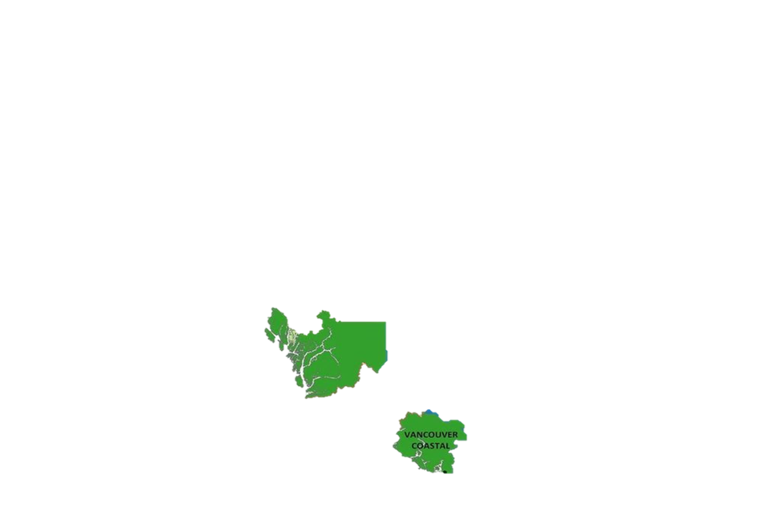
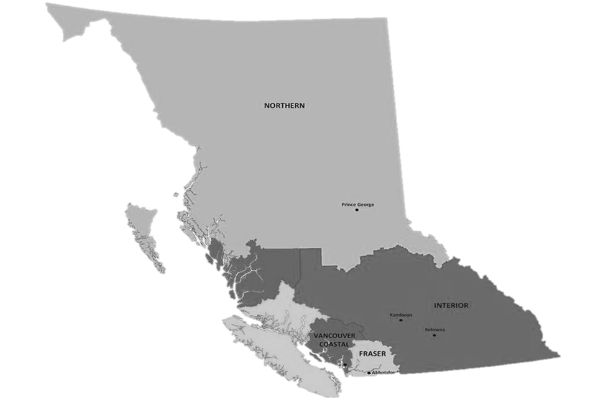
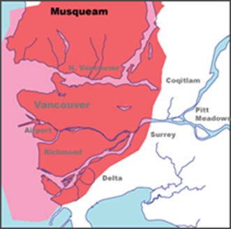
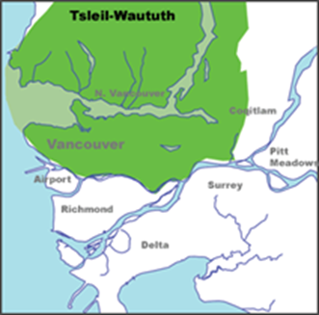
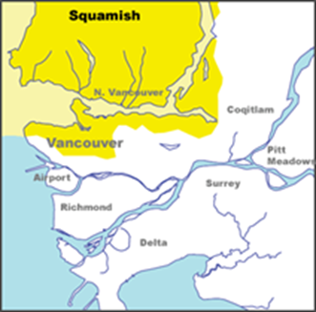
Territorial Acknowledgment
  We wish to acknowledge that the land on which we gather is the traditional and unceded territory of the Coast Salish Peoples, including the Musqueam, Squamish, and Tsleil-Waututh Nations.
Vancouver Coastal Health is committed to delivering exceptional care to 1.2 million people, including the First Nations, Métis and Inuit, within the traditional territories of the Heiltsuk, Kitasoo-Xai'xais, Lil'wat, Musqueam, N'Quatqua, Nuxalk, Samahquam, shíshálh, Skatin, Squamish, Tla'amin, Tsleil-Waututh, Wuikinuxv, and Xa'xtsa.
Notes:
Notes:
A territory acknowledgement is a relational process. This means that the meaning and purpose changes across time and space, and with the specific context in which it takes place. Take some time to learn about the territory on which the school you are in is situated and connect the honouring to the context of the classroom and module concepts. We encourage you to expand upon your territory acknowledgements in a meaningful way.
Suggestion: Make your land acknowledgement personal and specific to the traditional land the school is on. Emphasize the importance of connecting to culture for well-being, and connect the concepts to be covered in the module to the land and Indigenous culture (e.g. In Indigenous culture, food is considered medicine that nourishes your mind, body and soul, or share about a traditional Indigenous game that comes from this territory, etc.).

Slide 5



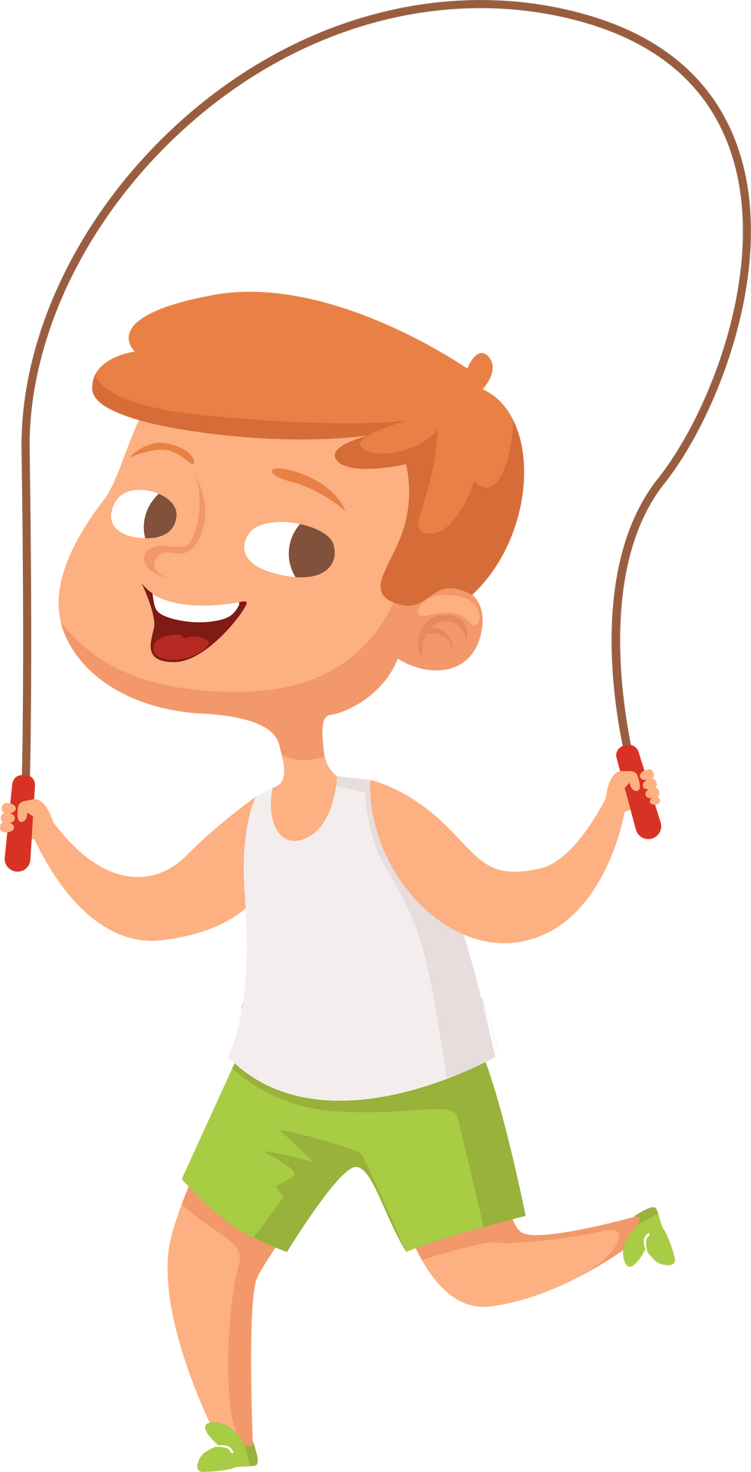
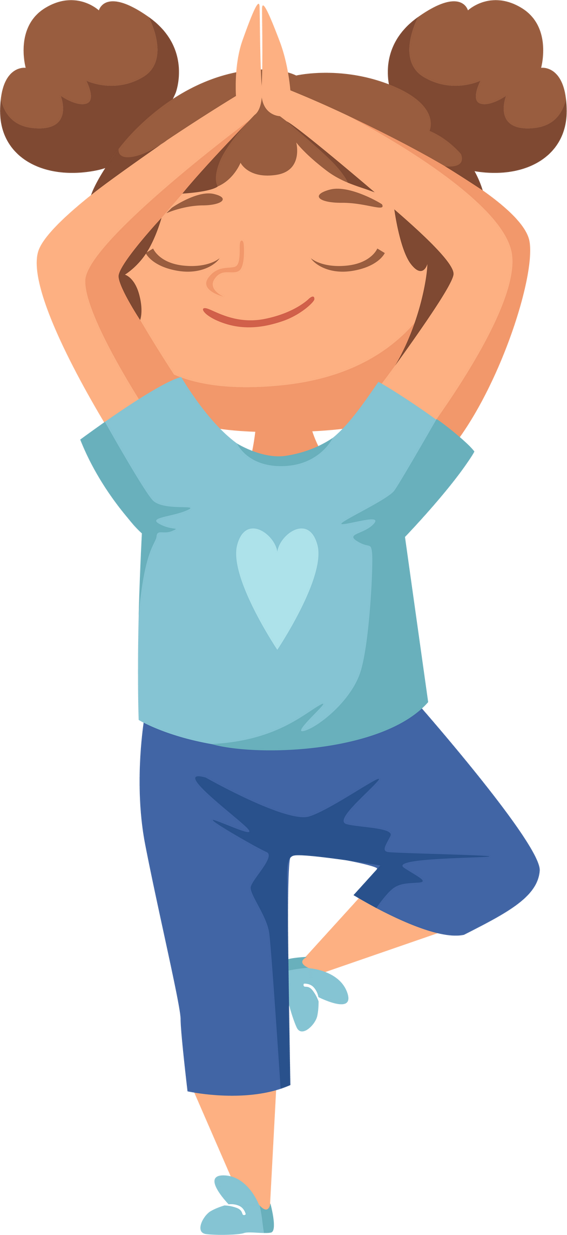
Check in:
True/False: What are some reasons to move our bodies for an hour everyday??
  Jump High
  if you think the answer is true
  Squat
  if you think the answer is false
Notes:
Check-In with Class: What are some reasons to move our bodies for an hour everyday?
Note: Jump if you think it’s true that activity can [insert line from below]_________; squat if you think it’s false
Boost your mood
Be fun
Make you feel more awake/energized
Help you sleep better
Help keep your body healthy and strong (prevent disease)
Learn skills and confidence you need to play games, sports, and participate in traditional activities
Can help you learn better (improve academic performance)
Help you focus
Be a great way to connect with friends and family

Slide 6

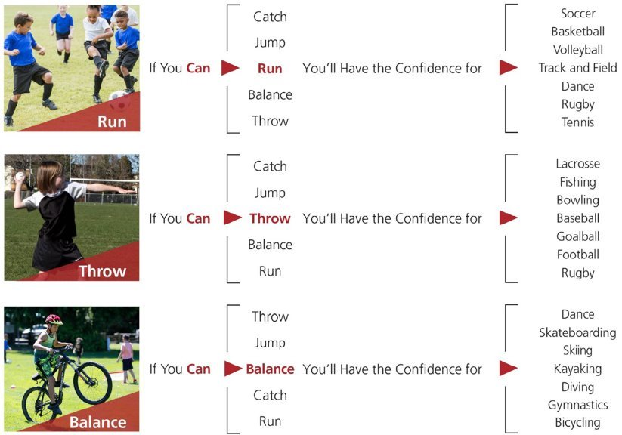
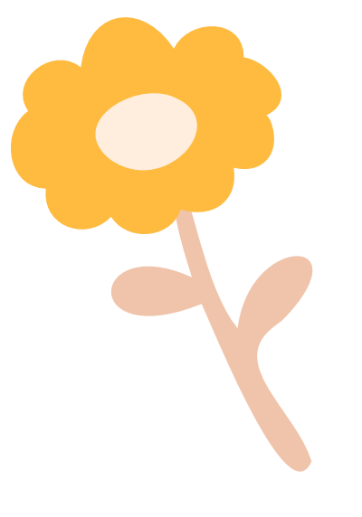
What is physical literacy?
Everyone
Meaningful Movement
Everywhere
More Often
Notes:
Note: Remind students what we talked about last week.
Who can remember what physical literacy is?
Note: Students can put their hands up to answer.
Last week, we learned that in order to move our bodies, we need physical literacy.
In order to move our bodies, we need physical literacy. Who here has a skill? [Choose someone with their hand-up]. Okay great, ______ is a soccer player. _______, do you remember the first time you played soccer? How did it feel? ​
​
That's right, the first time you tried it, it was probably quite hard, and a little scary even! Before you can play a full game of soccer, there's lots of smaller skills you need to learn, called fundamental movement skills. For soccer, we need to know how to run, how to balance and stand on one leg, how to kick, and many other things. But the more we practice those movement skills, the better we get at them, the more confident we feel, and the more fun we have. When we learn how to move our body in all different ways to learn these movement skills and we feel confident and happy doing them, that means that we are physically literate. It also makes us want to try learning more new activities and ways to move our body throughout our lives!​
​
Note: comparing physical literacy to 'literacy,' (reading + writing- first you need to learn sounds, then individual words, then sentences, etc.) can be a helpful way for students to understand this concept. For example, before we can play soccer, we have to learn how to run, to stand on one leg, to kick, then we can begin learning how to pass the ball, how to dribble, and eventually we can try playing a scrimmage.

Slide 7


How does physical activity help our brain?
Body
Brain
Emtions
Notes:
In this video, we’re going to learn about the benefits of physical activity for our brain.
The video is embedded on the following slide.
Hook: Brain scientists are going to talk to us about how physical activity helps the brain.
Note: Before the video starts, ask the students if they can name any benefits of physical activity.

Slide 8
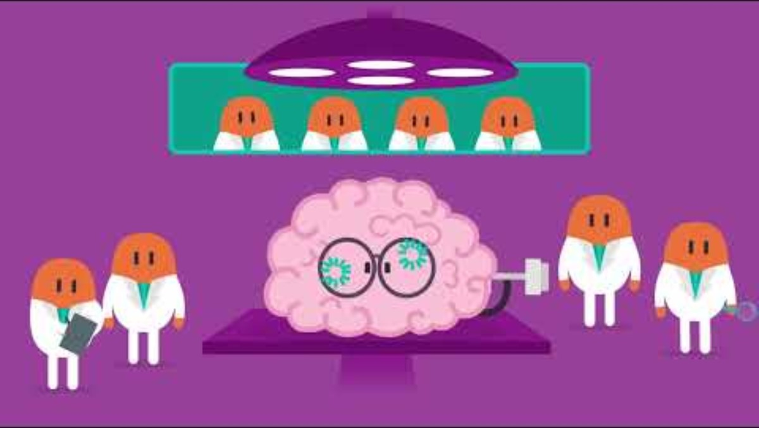
Body
Bran
Emotions
Notes:
In this video, we’re going to learn about the benefits of physical activity for our brain.
Click on the hyperlink text or the film icon to go to the video.
Note: What are some of the ways physical activity helps our brain? Better memory, focus, faster learning, better creativity, problem solving, and lower risk for mental illnesses and diseases.
Bonus: Who heard the name of the chemical they mentioned? It’s:
Brain
Derived
Neurotrophic
Factor
Brain derived = from the brain, neurotrophic = makes cells in your brain and spinal chord (neurons)

Slide 9
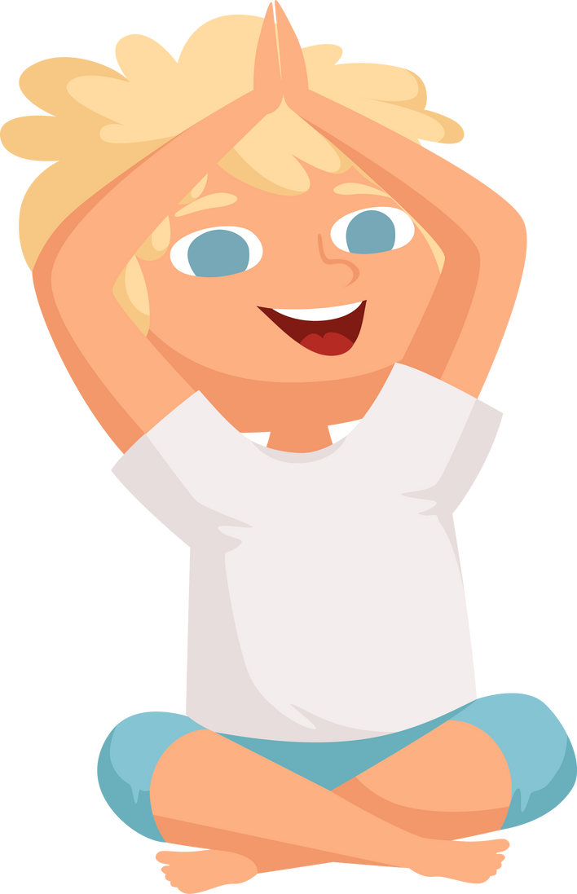
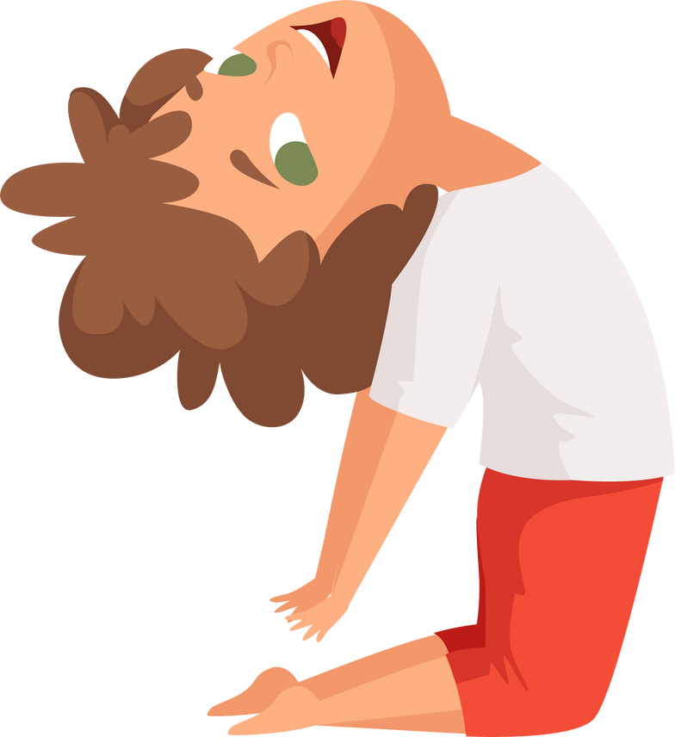
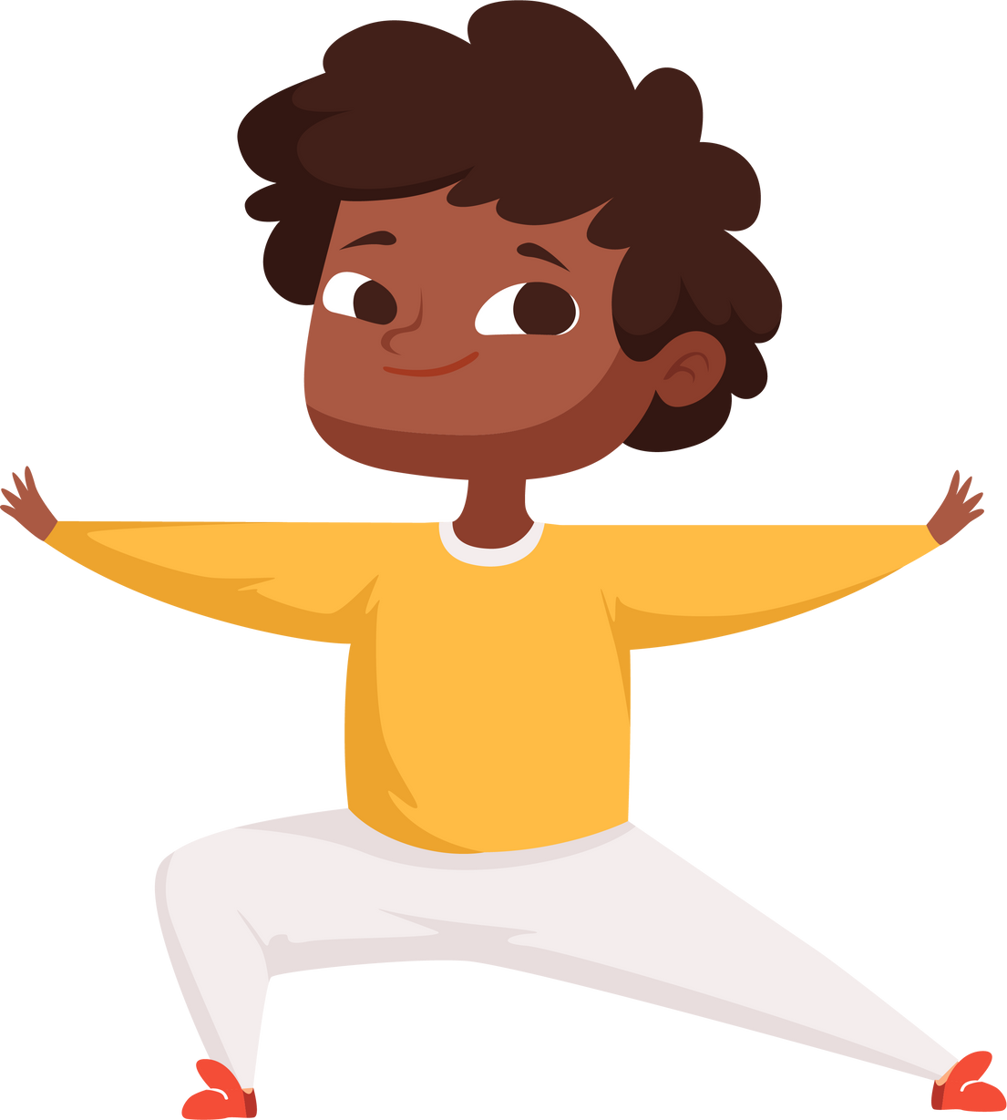
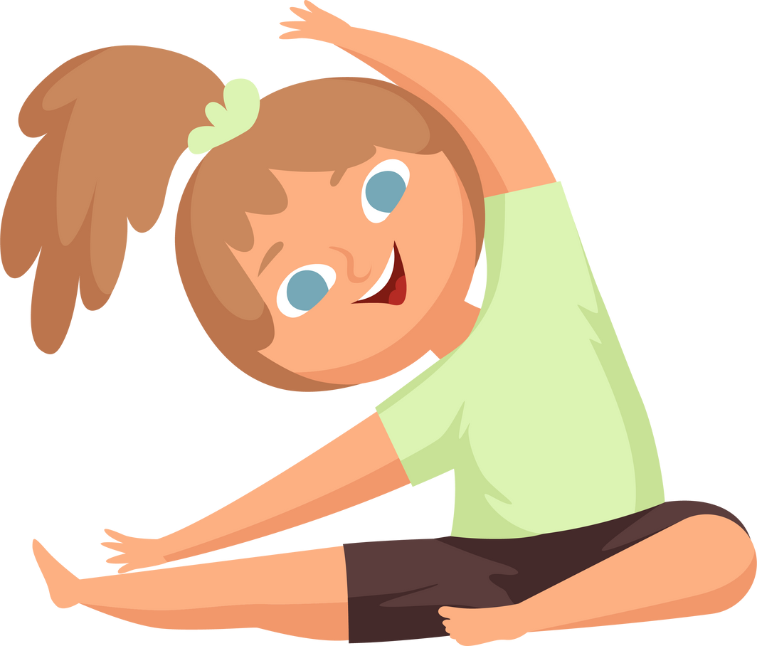
Did you know having Physical Literacy skills helps you make friends?
Notes:
Note: Use this slide to capture students’ attention before moving onto a more fulsome discussion on the next slide.

Slide 10



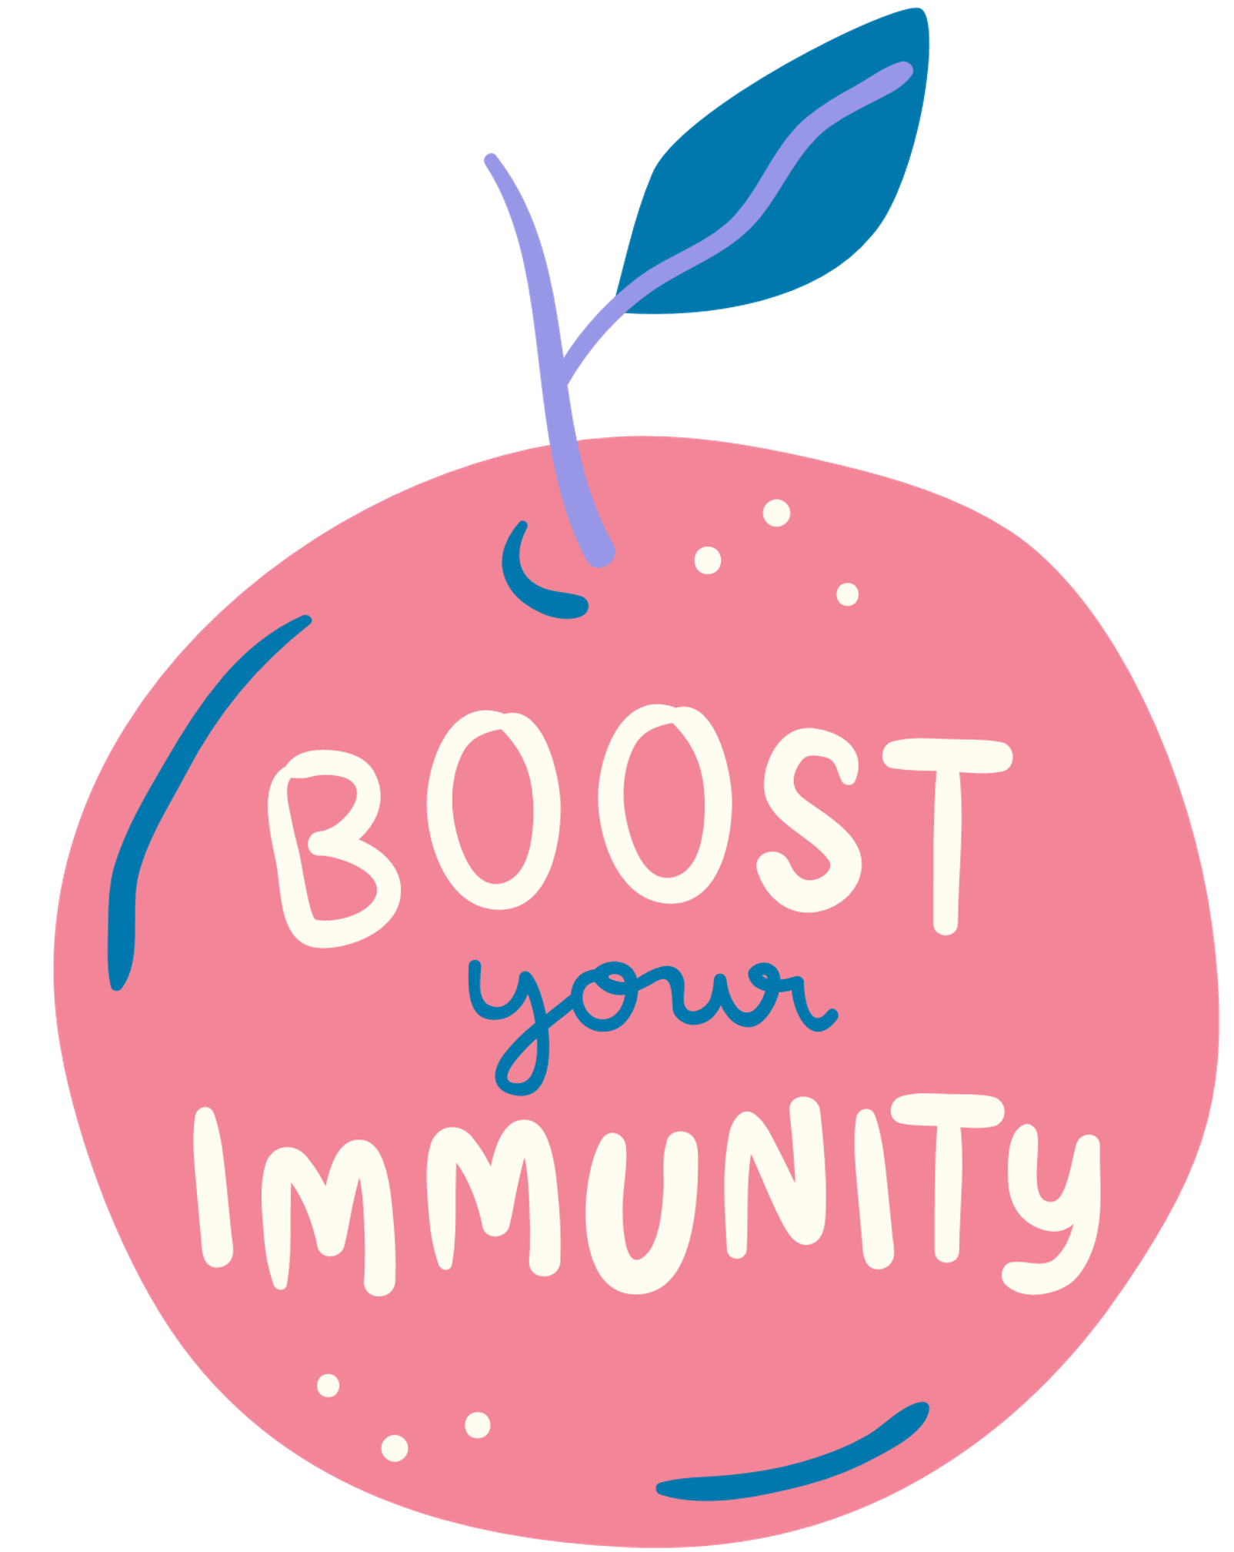
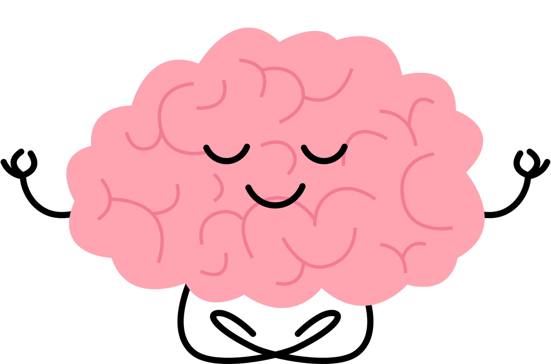

Why is it important to connect with others?
Biggest thing that makes people happy
50%
Increased chances of living longer
Helps the ability to understand what someone else is feeling and the ability to 'bounce back' after tough events
Strengthens the ability for body to protect itself (immune system) and gives self-confidence
Reduces worry and sadness
Notes:
Note: To build on those points, share some, or all of the points below:
As young people, being able to move well in all ways, on multiple surfaces helps build fundamental movement skills, helps us build strong bones and muscles, builds self-confidence and protects against injury. It also helps us feel good, manage our emotions, and connects us with others.
Having good friends and people you can count on is one of the best ways you can live a long life. Knowing this, we need to protect our ability to move across our life span. We protect our bodies by building these proper movement patterns as children and youth through physical literacy development and participation in activity -and by moving more often every day.
Learning how to move can help connect you with your community- for example, learning how to balance can allow you to help your grandmother walk with you to school, and learning how to throw allows you to participate in traditional Indigenous games like lacrosse.
Moving and participating in sport and physical activity is one avenue to make friends. Connecting with friends and family through growing food in the garden, cooking together, or eating together is another great way.

Slide 11
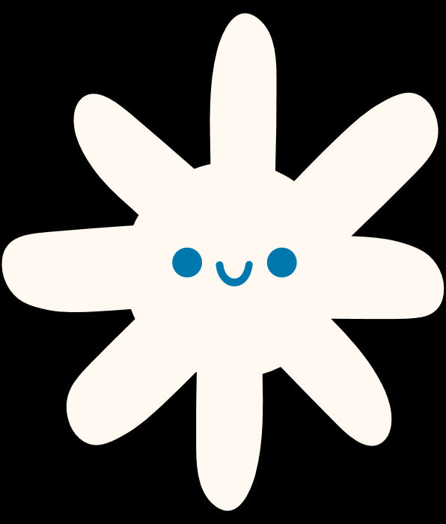

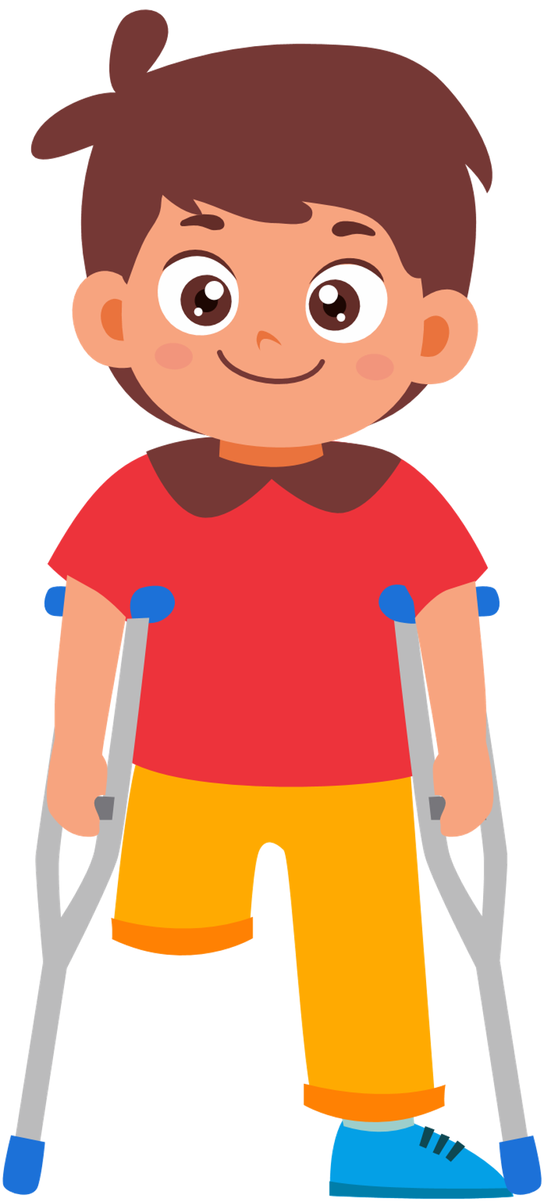

Movement Break!
5-4-3-2-1
Notes:
Note: Bring your premade popsicle sticks with you - You can have the students choose the 5 or you can choose them.
Place the popsicle sticks in a jar or in a bag and have a student choose one activity at a time. Use the choice jar to build your activity list. Anyone can be the picker – to encourage student listening and engage the teacher, ask the teacher to choose students who are showing good listening skills to pick the popsicles.
Can I have a volunteer to choose our activities? Okay thank you ______. Our first activity for 5 reps is ____________.
Have the student (and yourself) model the activity chosen. The first exercise that’s pulled out will be done for 5 reps, the second for 4 reps, etc. Repeat the 5, 4, 3, 2, 1 sequence once and allow different students to choose the exercises. Be sure to model the proper form for each exercise before starting.
Let’s Move…
Play 5, 4, 3, 2, 1
(2 Rounds)
5 Squats
4 Jumping Jacks
3 Lateral Jumps
2 Toe Touches
1 minute running on the spot

Slide 12


Let’s play again!
5-4-3-2-1
Toe touches
Squats
Jumping Jacks
Sit ups
Lateral jumps
Running on the spot
Frog jumps
Tuck jumps
Star jumps
Notes:
Now let’s play with a friend!
Repeat the activity from slide 11 as a class, with different students selecting the popsicle sticks. Have students turn to the person beside them and face each other when doing the exercises.
Did your partner encourage you?
Did your partner make your work hard?
Fist pump when you are done and thank them for helping you stay active.
Note: You may also choose to just repeat the previous slide again if you prefer.

Slide 13
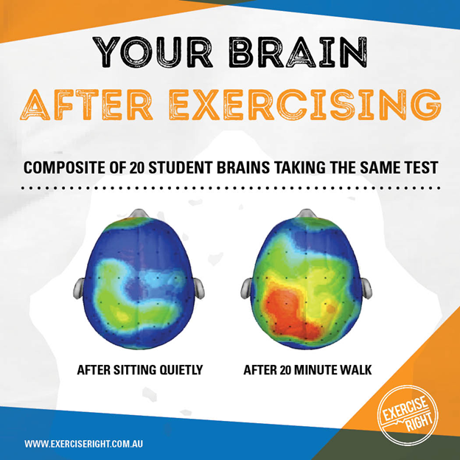

MOVEMENT MAKES US LEARN BETTER
(Hillman et al., 2009)
Notes:
Do you see a difference between the brain on the right and the one on the left?
See how the one on the right is so much more colourful? This is what we call the rainbow brain. The one on the right represents a brain that has recently done activity, the blue brain represents a quiet or inactive brain. Both brains did a math test after they sat or played for 20 minutes outside. Which brain do you think did better on the Math test?
In our class, we like to have rainbow brains as much as possible so that we can learn at our best- that’s why we are doing all these active breaks in class!
Full reference: Hillman, C., Pontifex, M., Raine, L., Castelli, D., Hall, E., Kramer, A., (2009). University of Illinois. The effect of acute treadmill walking on cognitive control and academic achievement in preadolescent children. Neuroscience. 159, 3: 1044-1054.
https://www.sciencedirect.com/science/article/abs/pii/S0306452209001171

Slide 14





GET YOUR DAILY DOSE OF HAPPY
Serotonin
Oxytocin
Dopamine
Endorphins
Notes:
When we’re active, a number of chemical reactions happen in our brain that create the ‘rainbow brain.’ Exercise releases a number of different chemicals (hormones): Dopamine (which makes you happy), Oxytocin (which makes you feel love), Serotonin (which makes you feel confident), and endorphins (which make you feel joy and excited). Has anyone ever experienced feeling these emotions after exercising hard?
DOSE means:
Dopamine
Oxytocin
Serotonin
Endorphins
Note: Other examples/mnemonics to help remember the different neurotransmitters:
Who knows someone who has had a baby? Oxytocin is released when a parent sees their baby for the first time (e.g. mother giving birth to a newborn)
If Serotonin was a person, they would have swagger (confidence)
Endorphins are released when someone makes a goal or wins. Who here has ever scored in basketball? The happiness you feel then is caused by endorphins.

Slide 15
MATCHING
Endorphins
Makes you feel happy
Makes you feel confident
Serotonin
Oxytocin
Makes you feel joy + excitement
Dopamine
Makes you feel love
Notes:
Let's match the hormone to the way it makes us feel! Let's start with endorphins, how do those make us feel? Let's match it with one of the answers on the right.
Go through all of the hormones until everything is matched correctly.

Slide 16


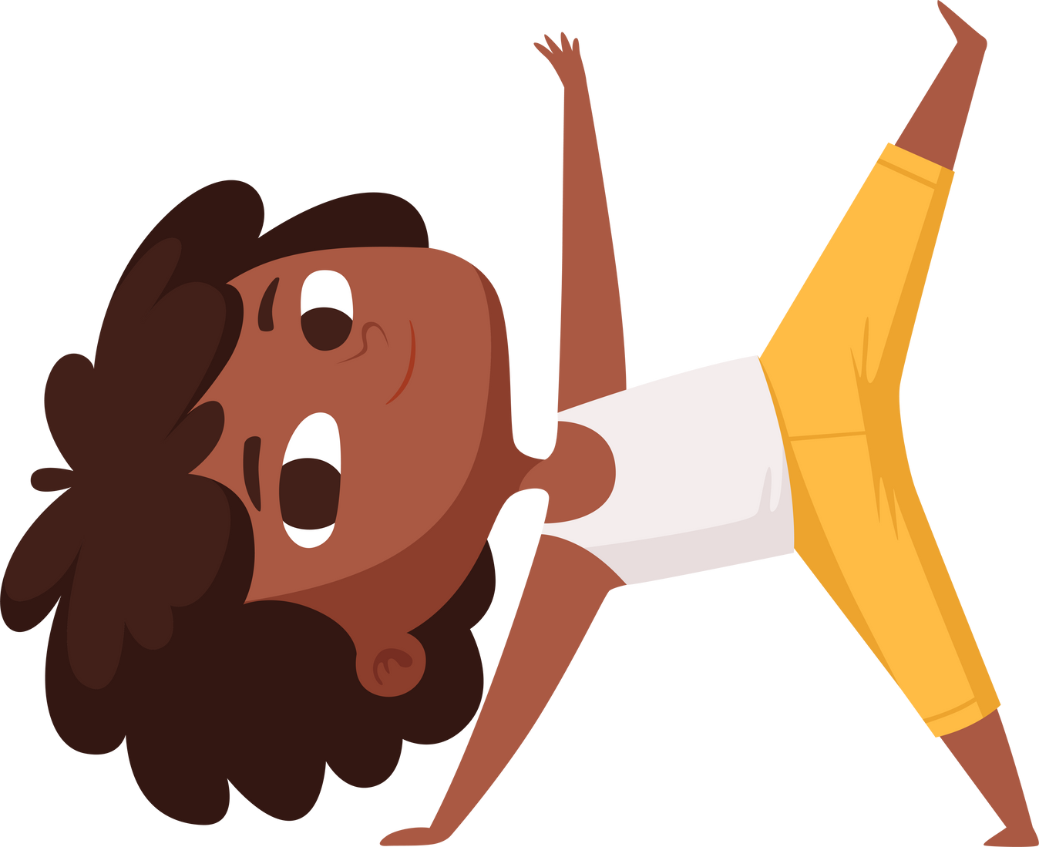


Try to keep moving the whole time.
Movement Break!
Minute to Win It
How many lateral jumps can you do in 1 minute?
Notes:
Notes:
Instruct every student to stand up and push their chairs in.
Demonstrate to the class how to complete a lateral jump and how you want it to be done in safe and correct form (Feet together, engage your core, and hop from side to side, left to right and back again).
Tell them to get ready and set your timer.
Countdown from three and GO!
Do it with them so they will follow your lead and not stop.
You just gave yourself a little dose of HAPPY. Can you feel your pulse in your neck? Or feel your heart beating faster? This means you did it right. You did not give up when things got uncomfortable.

Slide 17

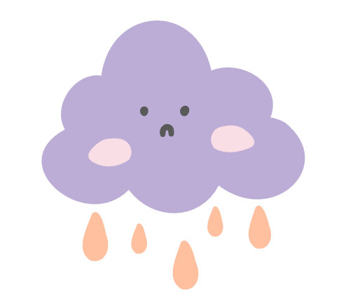




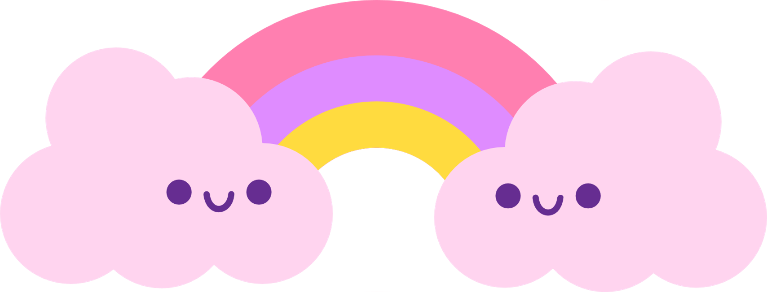
How do you feel now?
Notes:
We just learned about how moving our bodies releases positive hormones in our brains. How are you feeling after exercising?
Stand up if you feel better - happier or more awake after moving your body.
Note: Check in with any students or the teacher after class for students who share that they are going through a tough time.

Slide 18
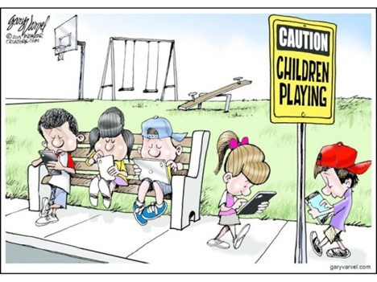
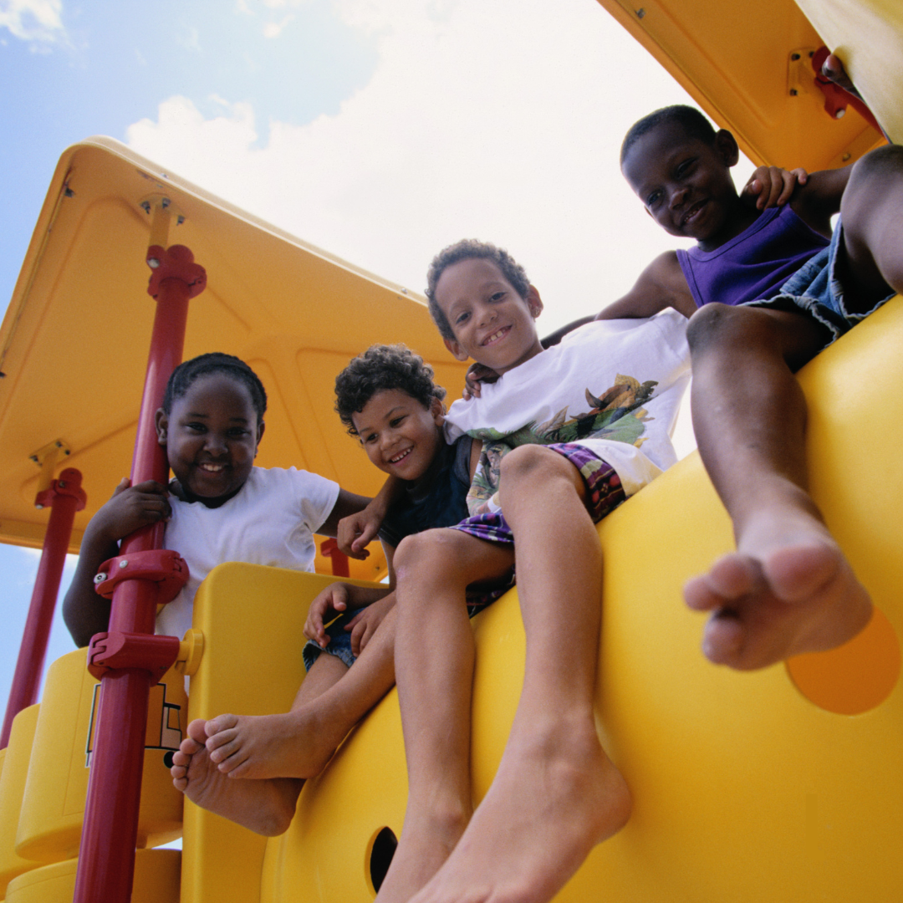
WHAT DO YOU THINK ABOUT THIS IMAGE?
Notes:
Note: An extra slide in case you are done early or the students are eager to discuss the top of social connection/screen time etc.
What do you think when you look at the picture on the left (e.g. the comic)? Are the students socially connected? How about the photo on the right?

Slide 19
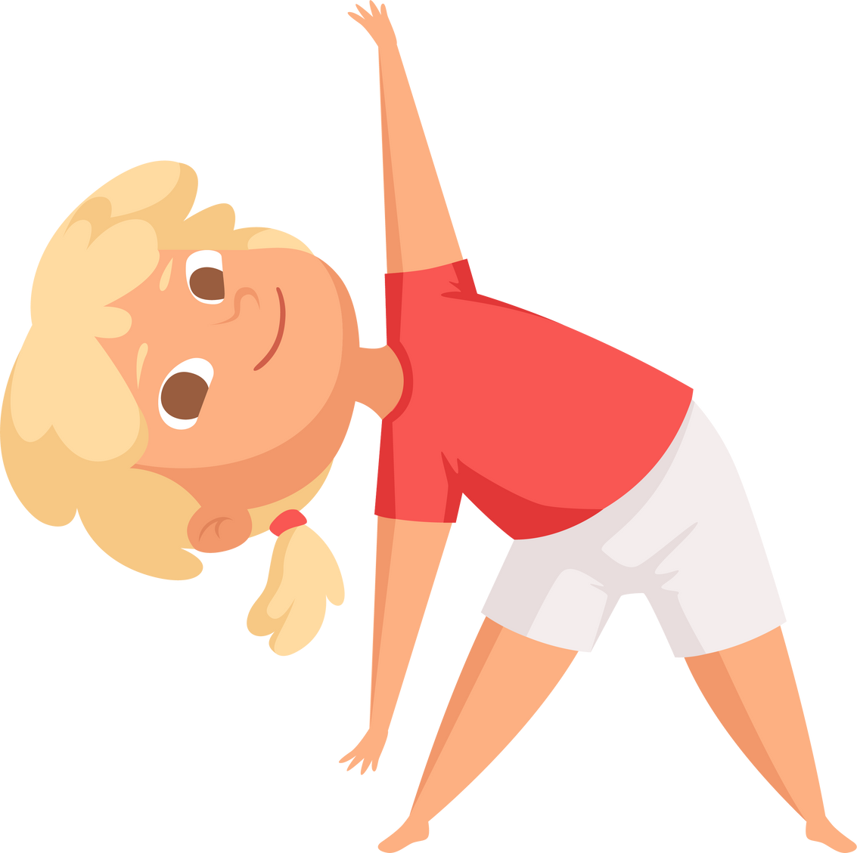
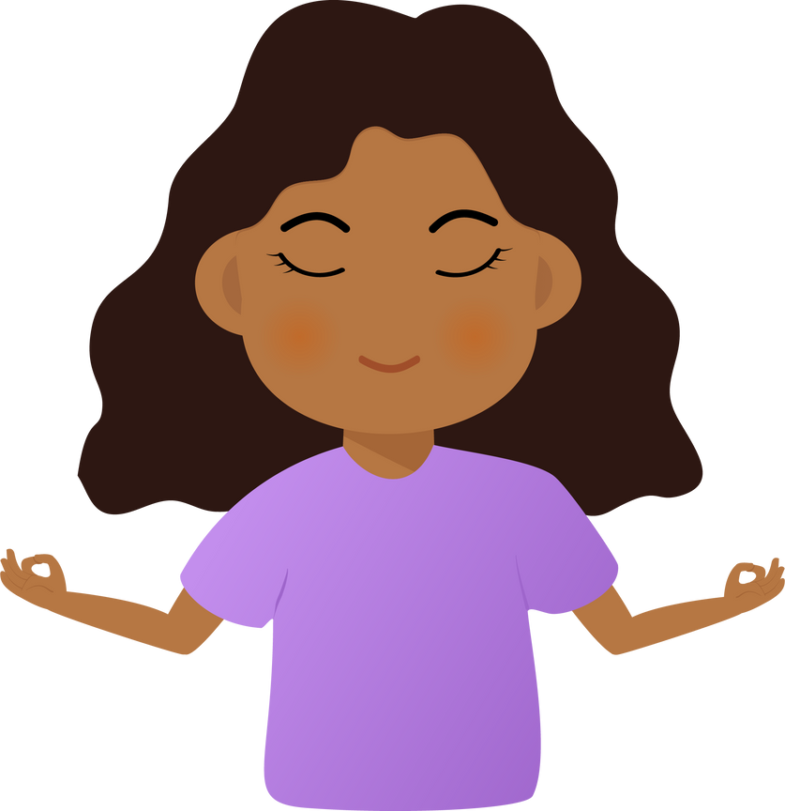
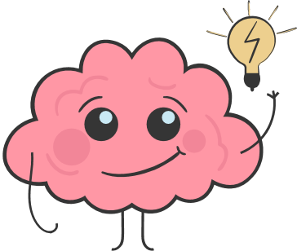
Movement Makes...
Our bodies
  healthier
  Our brains learn better
Our bodies
  calmer and happier
Notes:
Notes: Have students say this message with you.
Movement makes:
Our bodies healthier!
Our brains better learners!
Our bodies calmer and happier!
Note: Thank the class for their engagement and sharing. Let them know that their teacher may continue to bring some of the fun activities into their classrooms.
The module manual accompanying these lecture slides can be left with the teacher as a reminder of the key concepts and as a tool to confidently bring these lessons into their classroom. Follow up with the teacher on sending them any lesson plans or supportive material.

Slide 20








Thank you to our contributors!

